Slide 1



Slide 2
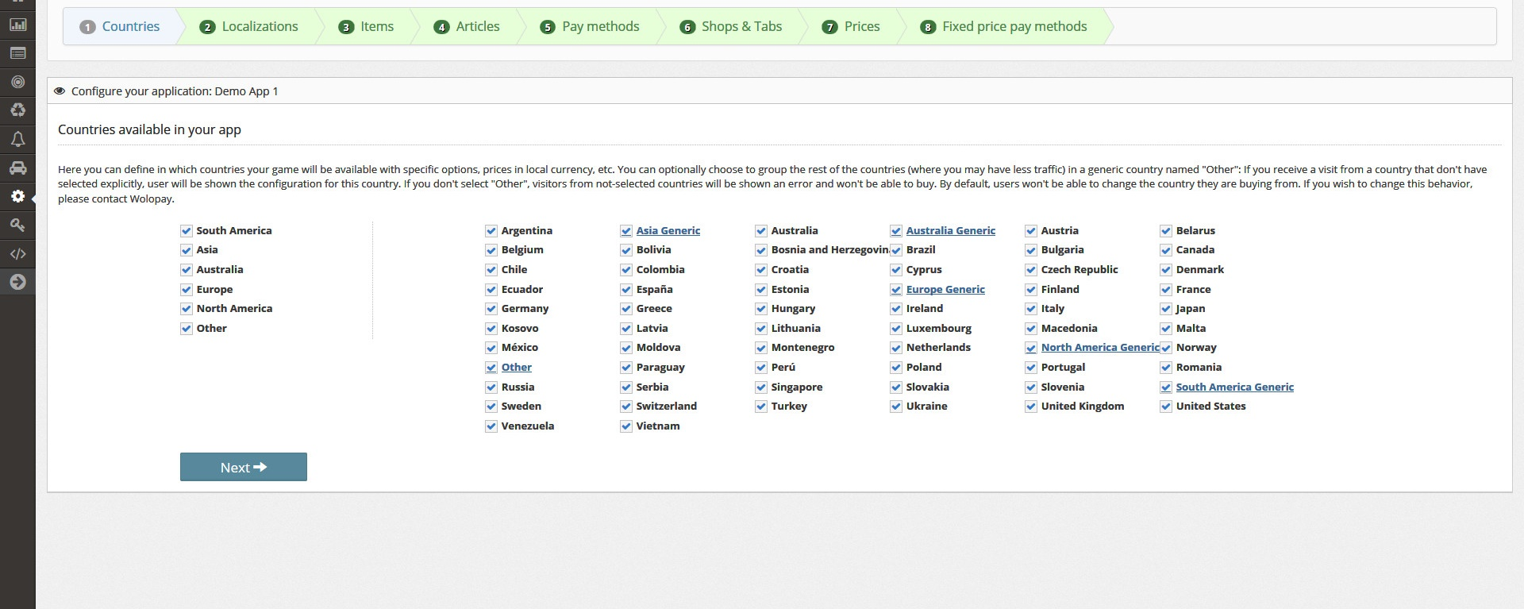
Step-by-Step Wizard: Countries Selection

Slide 3
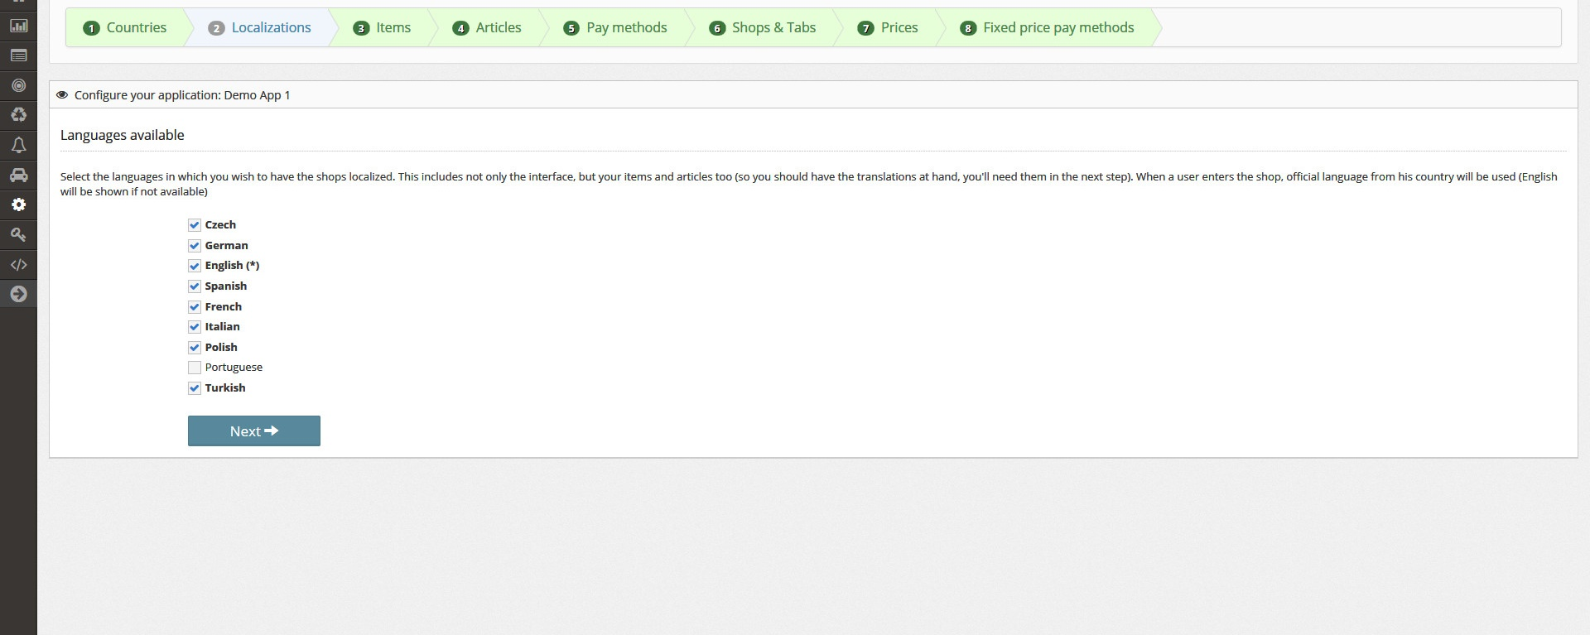
Step-by-Step Wizard: Localizations

Slide 4
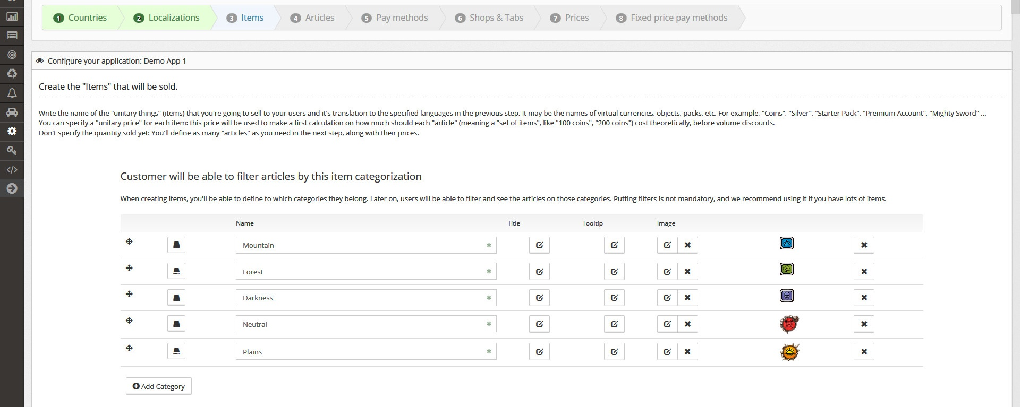
Step-by-Step Wizard: Item Filters

Slide 5
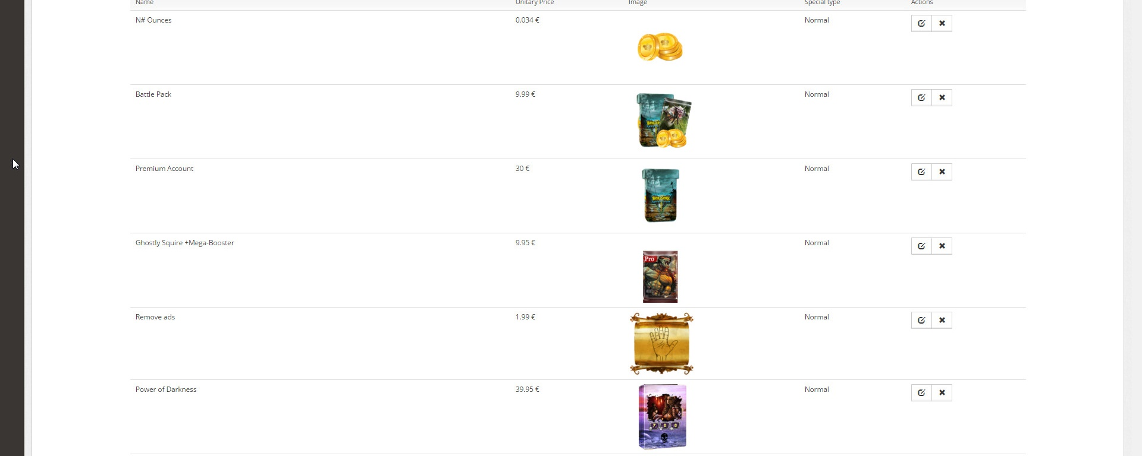
Step-by-Step Wizard: Item definition

Slide 6
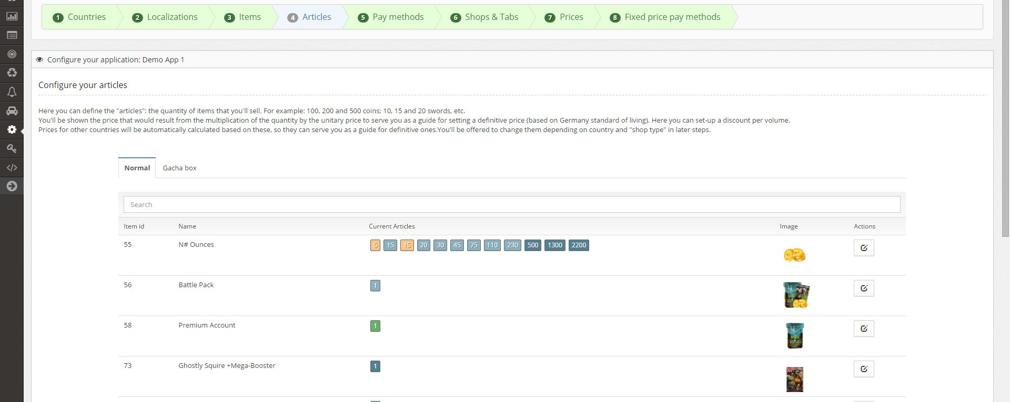
Step-by-Step Wizard: Articles (packs of items)

Slide 7
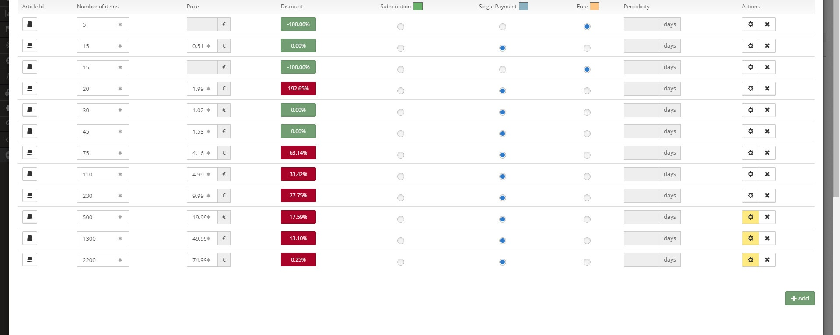
Step-by-Step Wizard: Setting article basic info

Slide 8
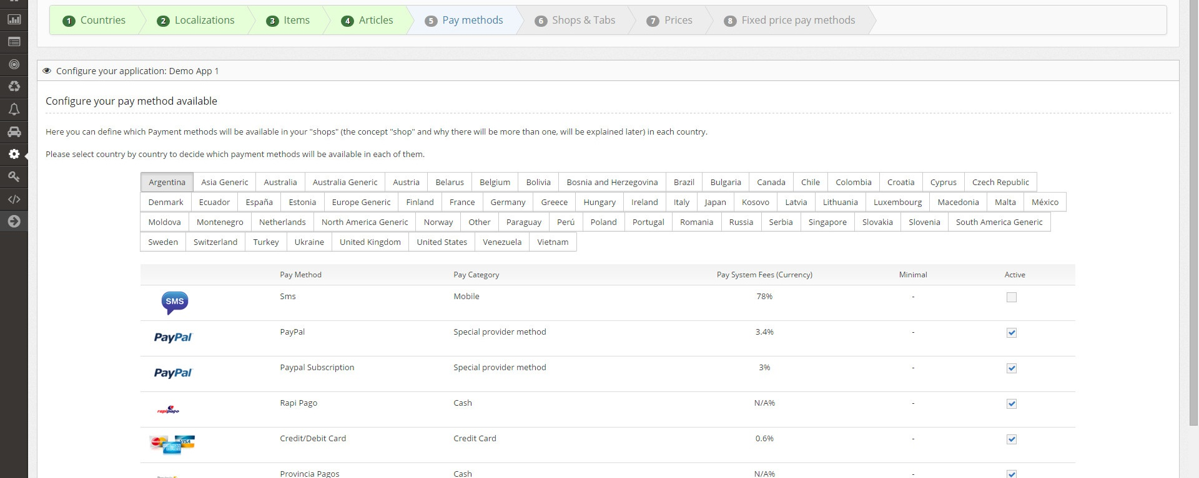
Step-by-Step Wizard: payment methods per country

Slide 9
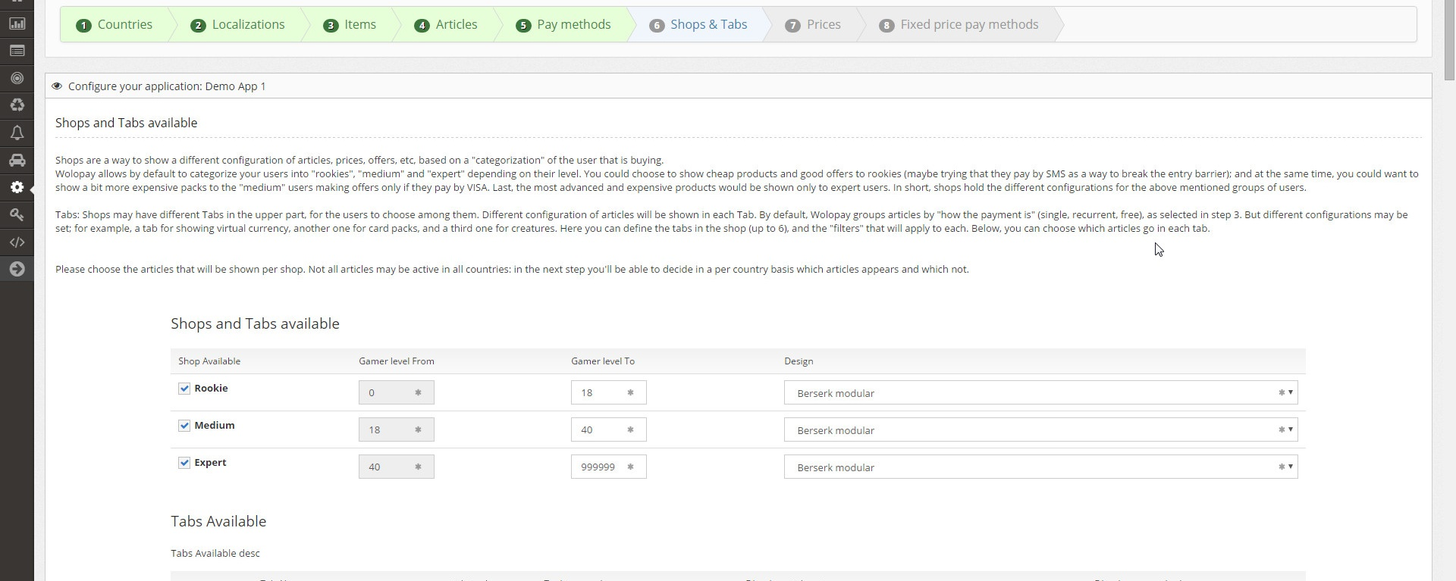
Step-by-Step Wizard: Shops. Configuration per user level

Slide 10
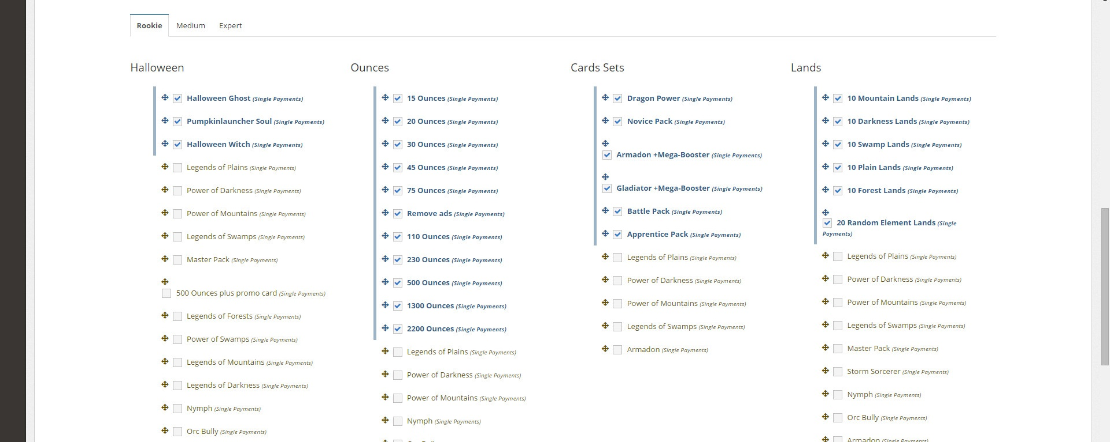
Step-by-Step Wizard: articles per shop and tab

Slide 11
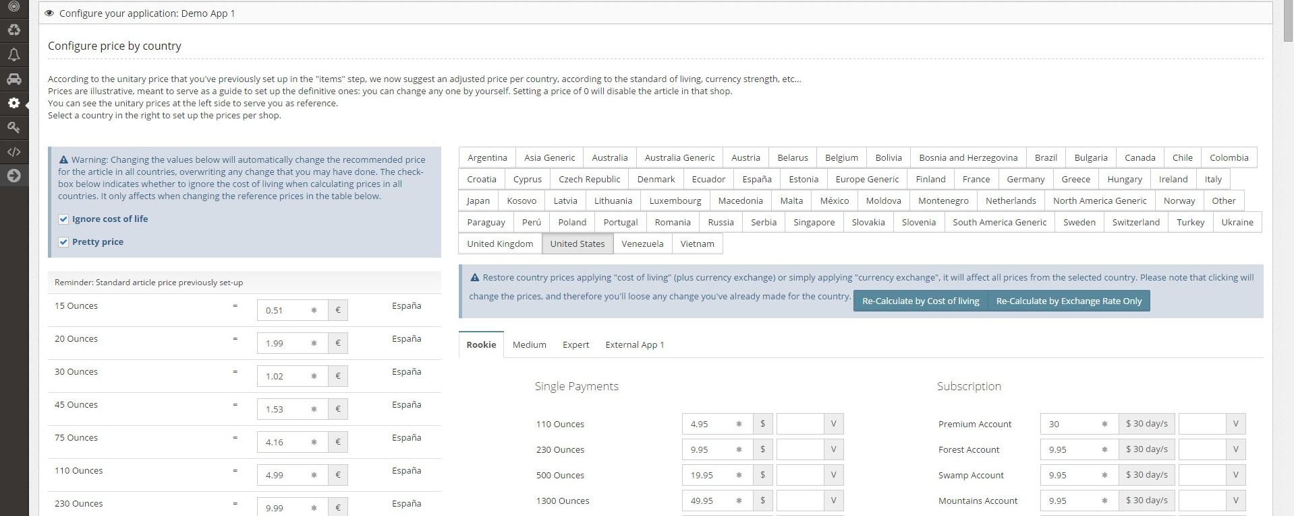
Step-by-Step Wizard: Prices per country (and virtual currency)

Slide 12
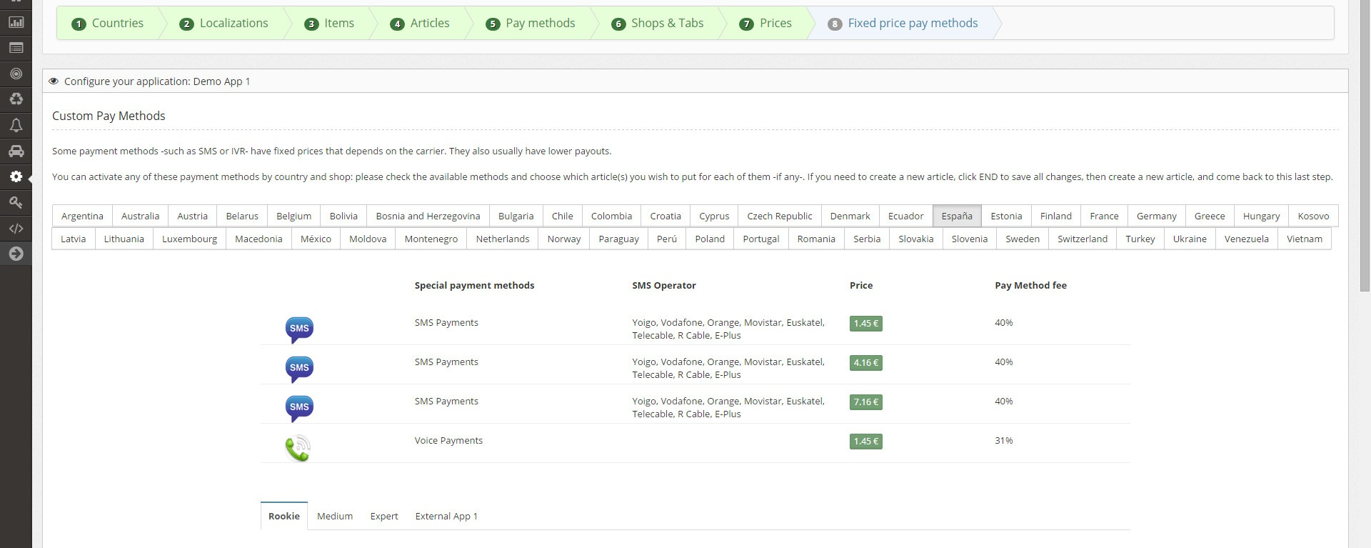
Step-by-Step Wizard: Fixed price paymet methods (SMS & IVR)

Slide 13
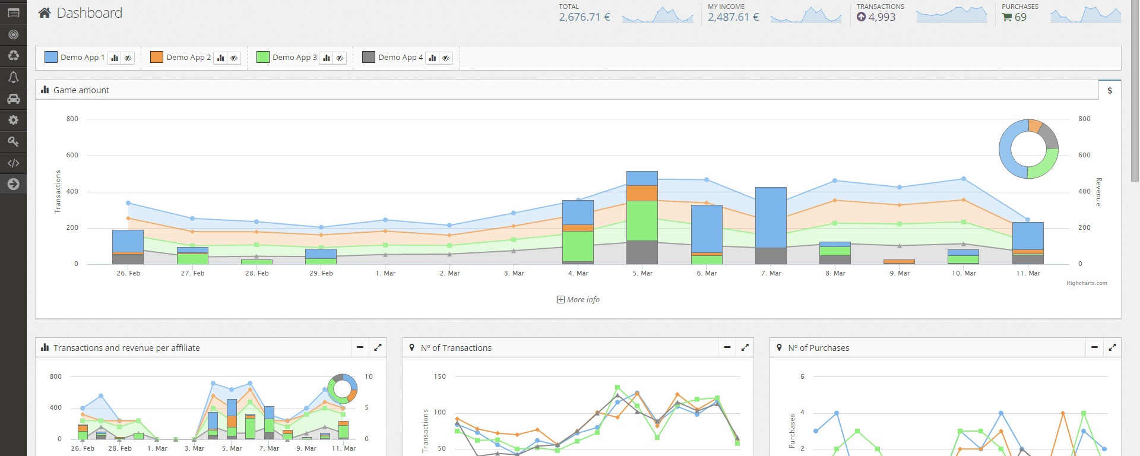
Dashboard

Slide 14
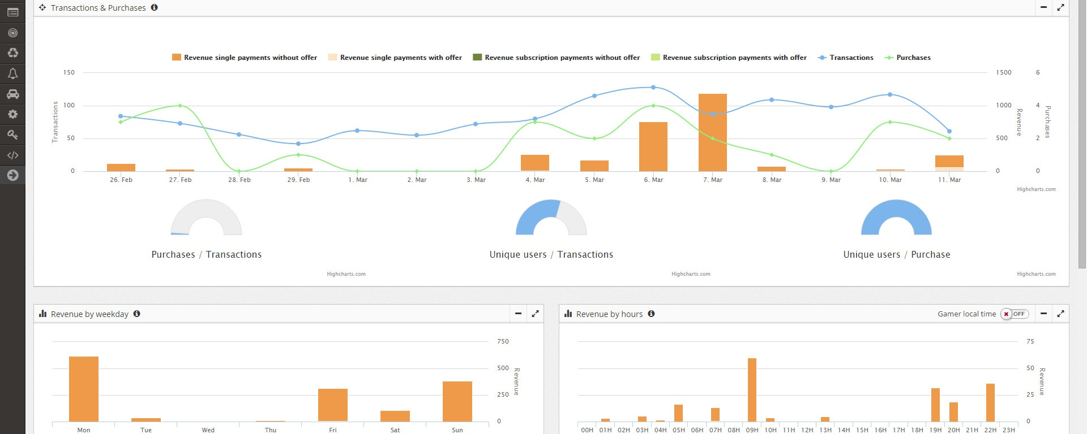
Analytics: Transactions, purchases, offers, by day, hour…

Slide 15
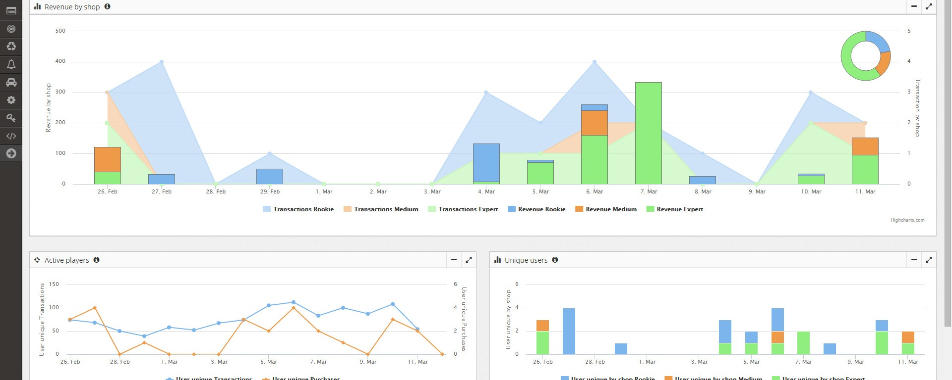
Analytics: Revenue by shop, DAU and DAU by shop

Slide 16
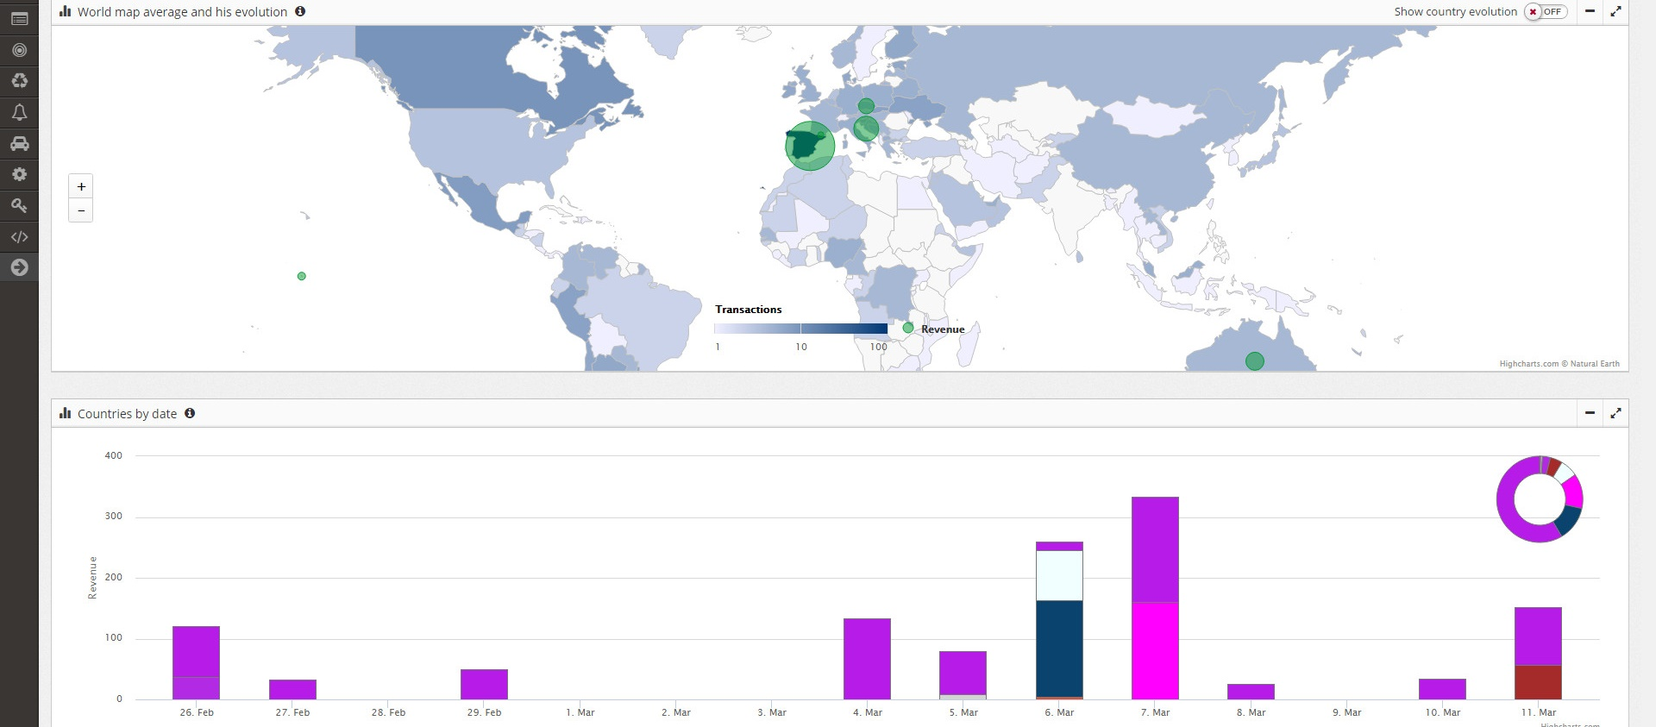
Analytics: per continent and country (plus evolution)

Slide 17
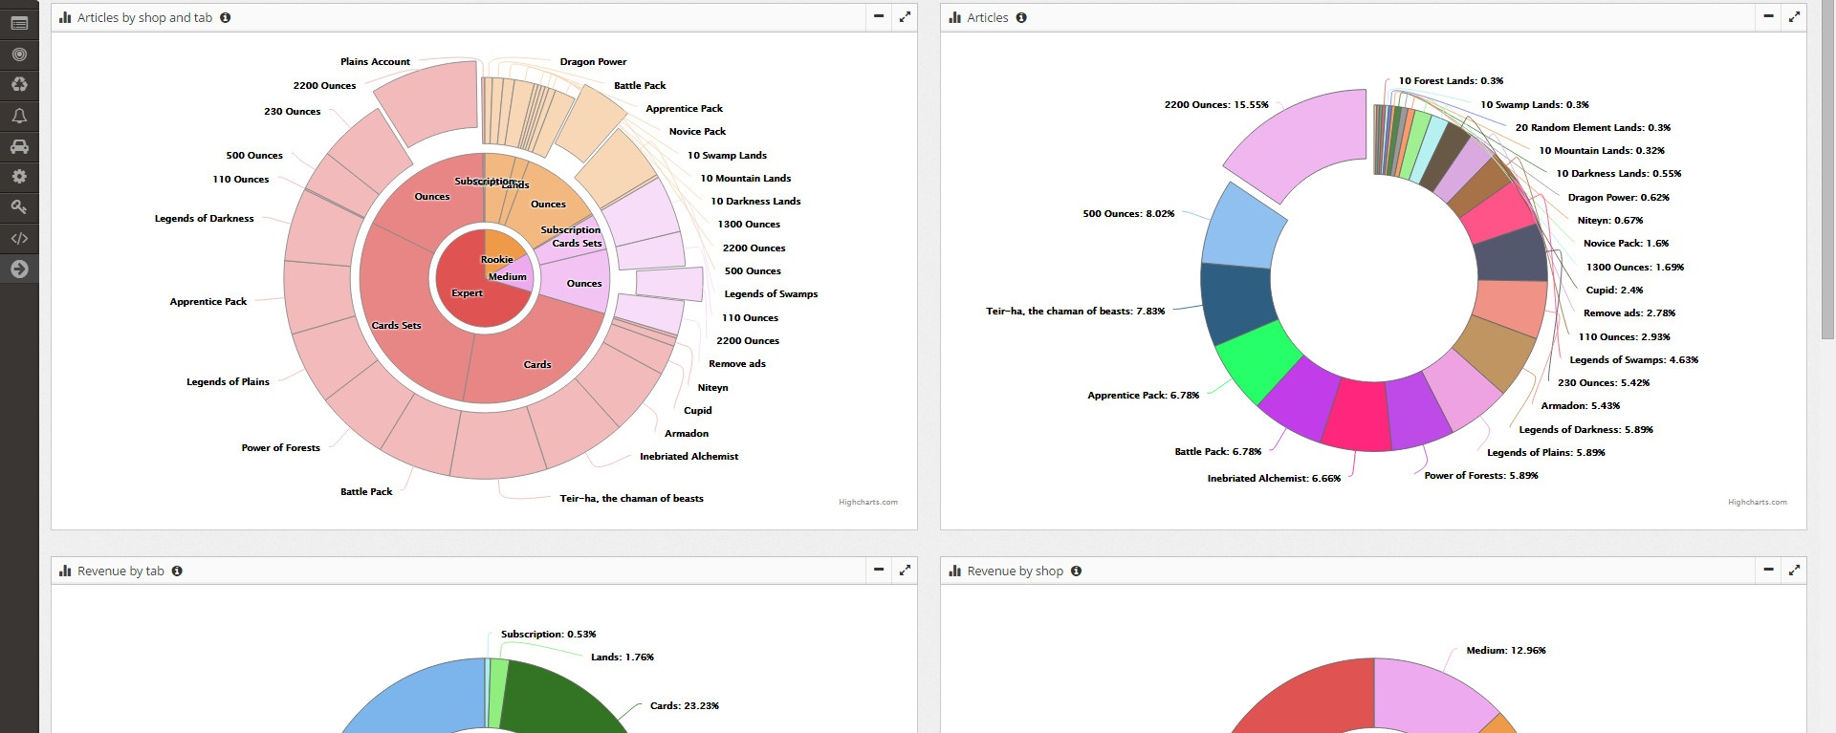
Analytics: distribution by article, tab and shop

Slide 18
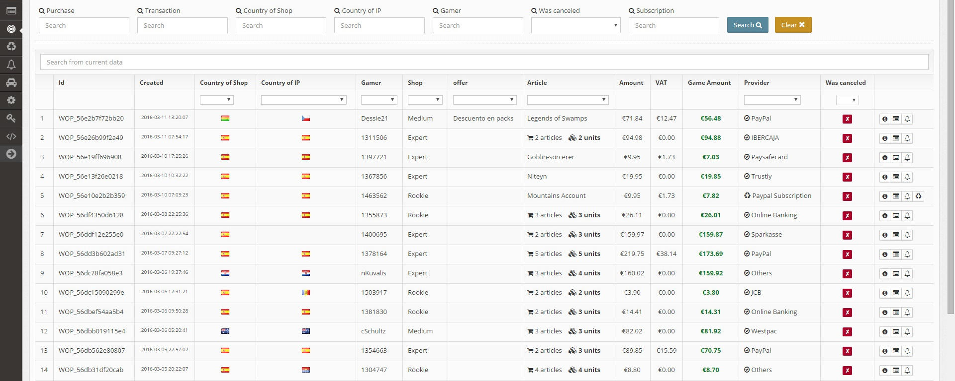
Purchases: List with details

Slide 19
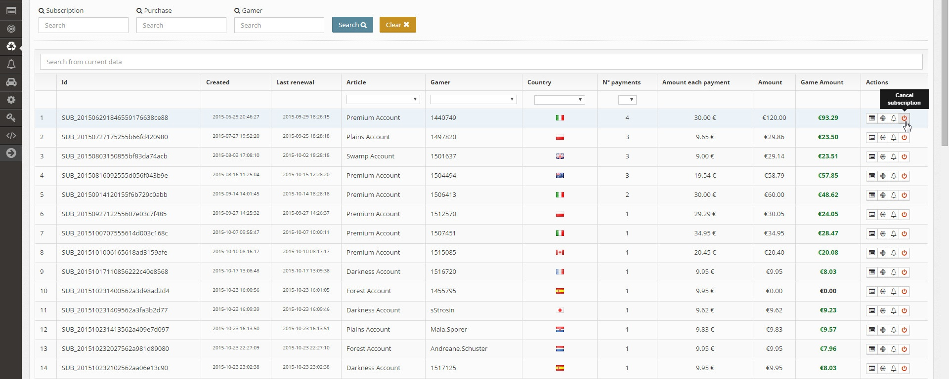
Subscriptions: List with possibility of cancelling by hand

Slide 20
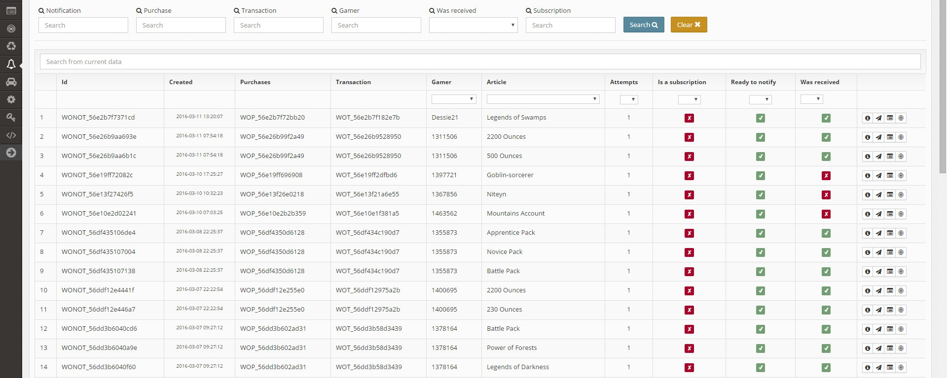
Notifications to the game

Slide 21
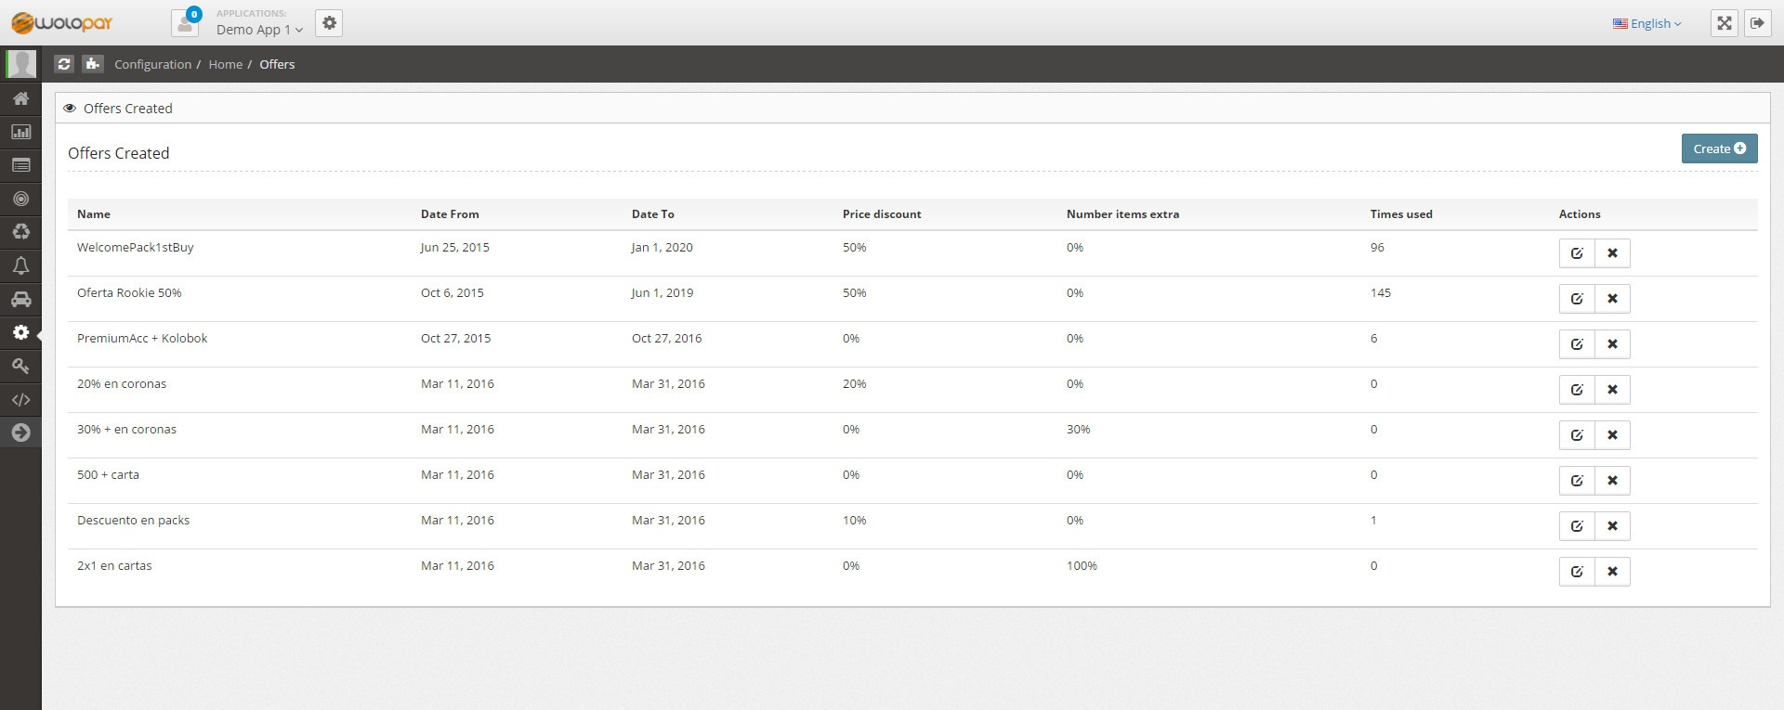
Offers: list and results

Slide 22
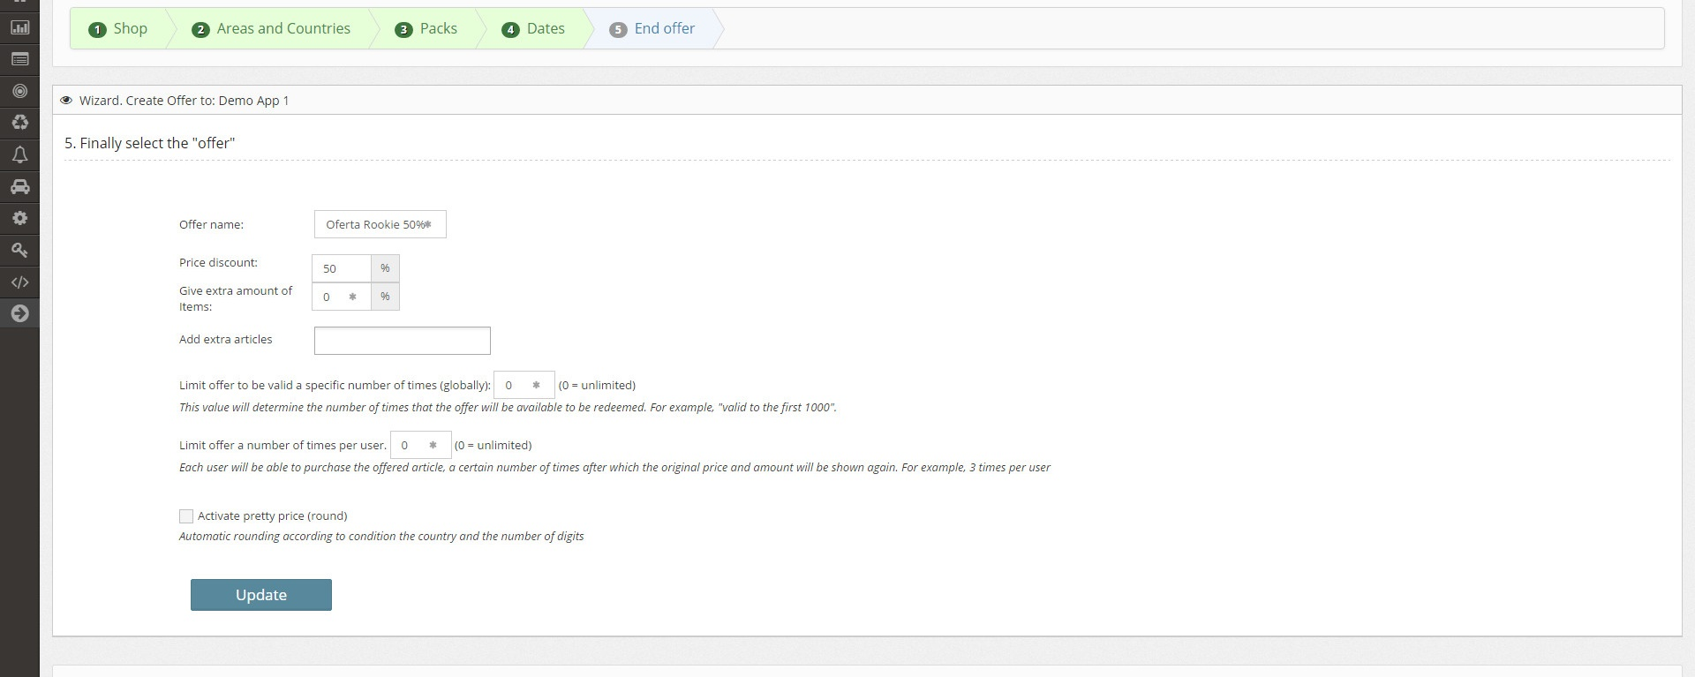
Offers: Step-by-Step Wizard

Slide 23
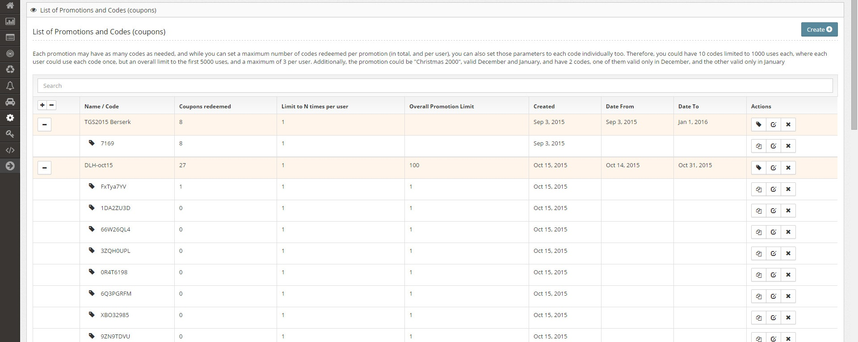
Coupons

Slide 24
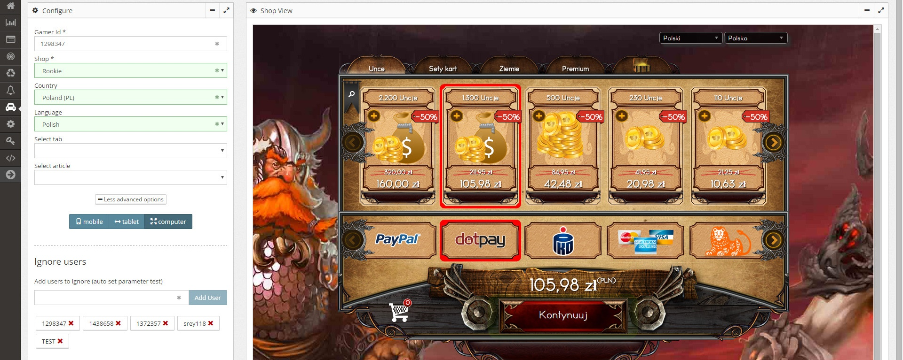
Testing the shop in different scenarios

Slide 25
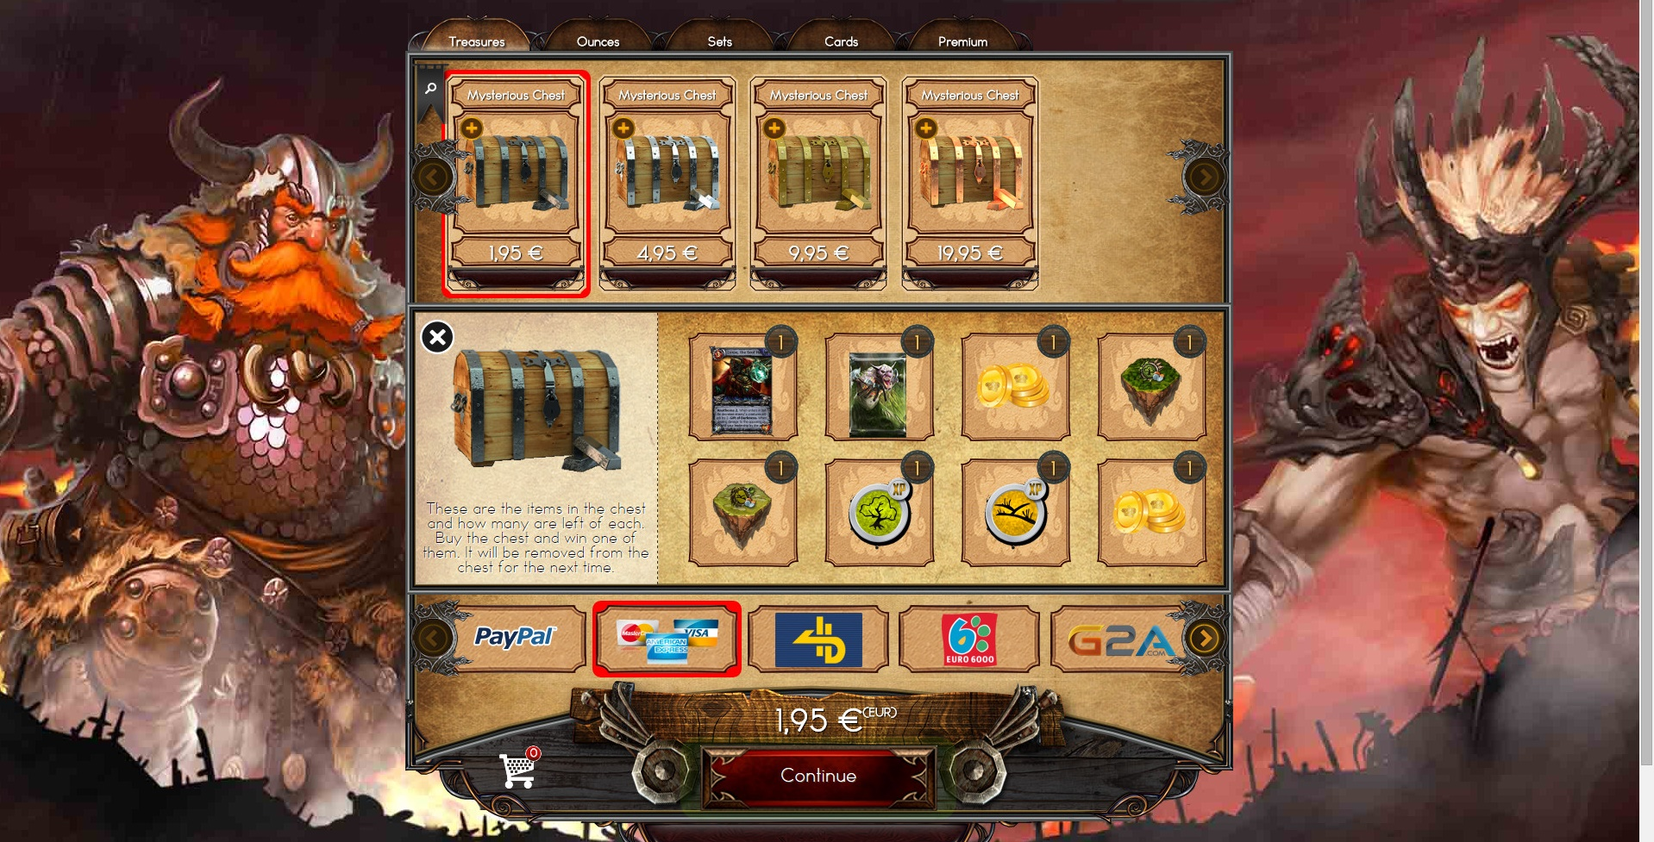
GACHAS

Slide 26
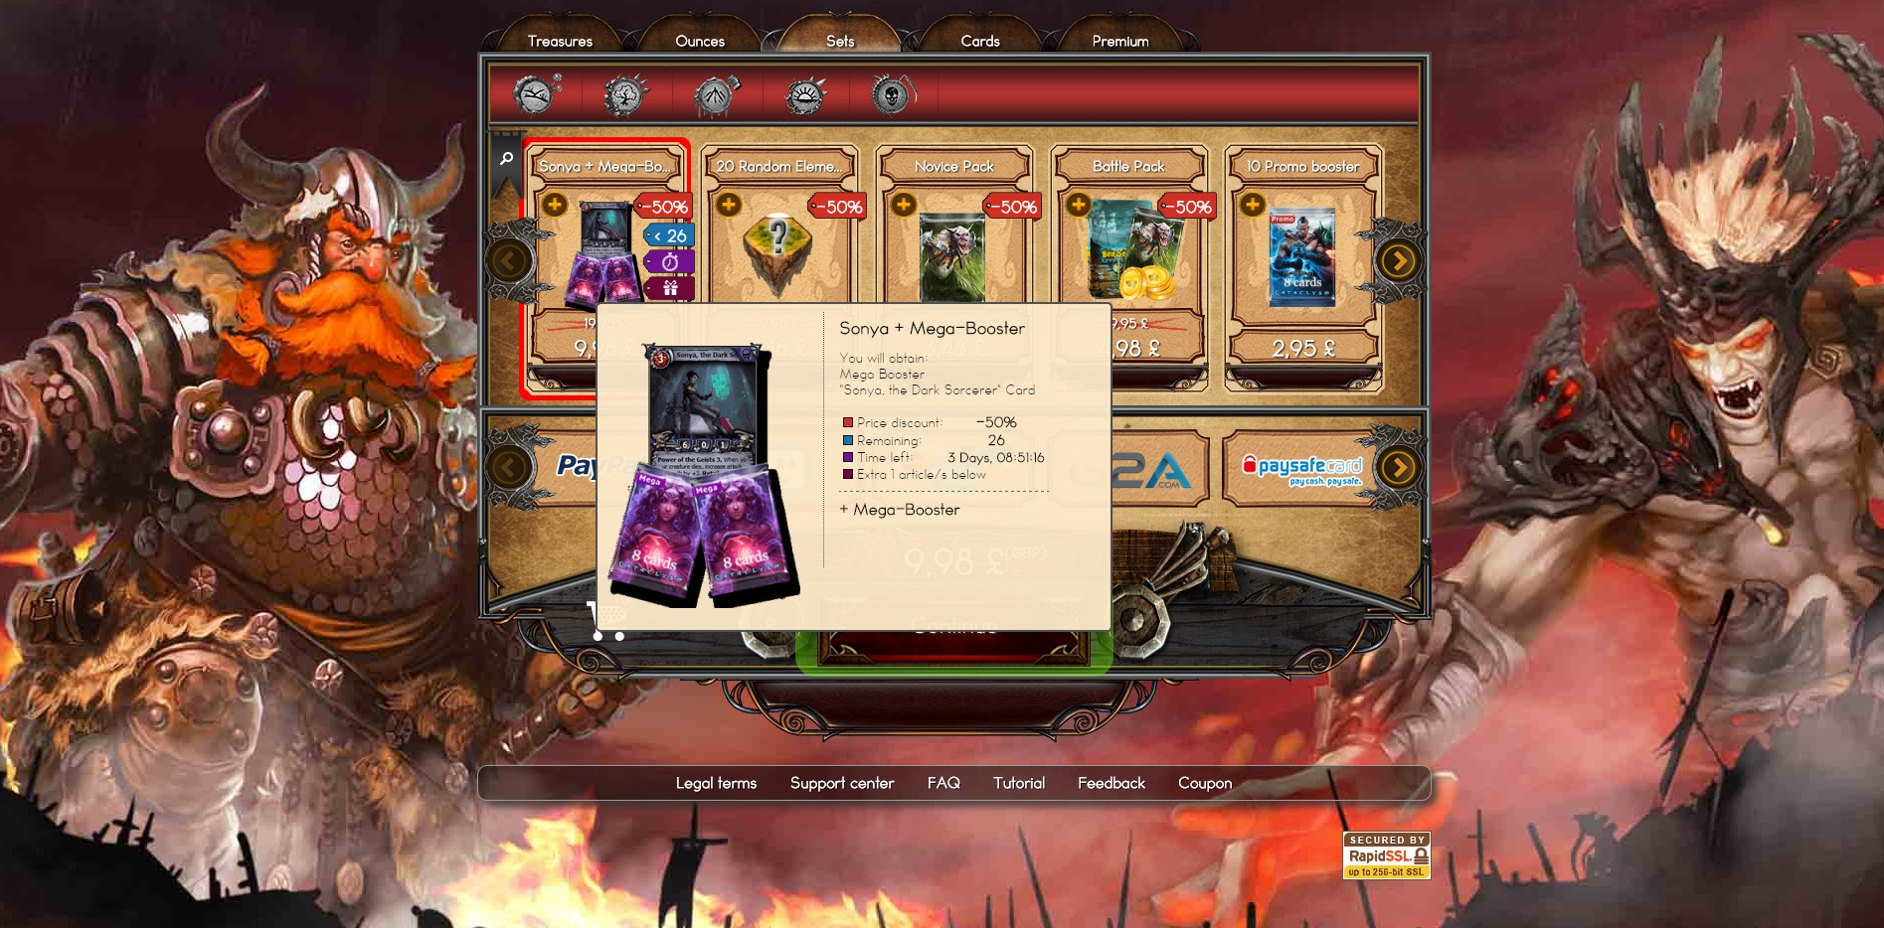
Filters, advanced description, price offer, limited units, time limit, article gift

Slide 27
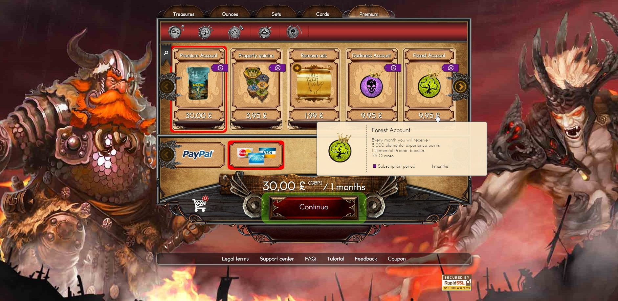
Subscriptions

Slide 28
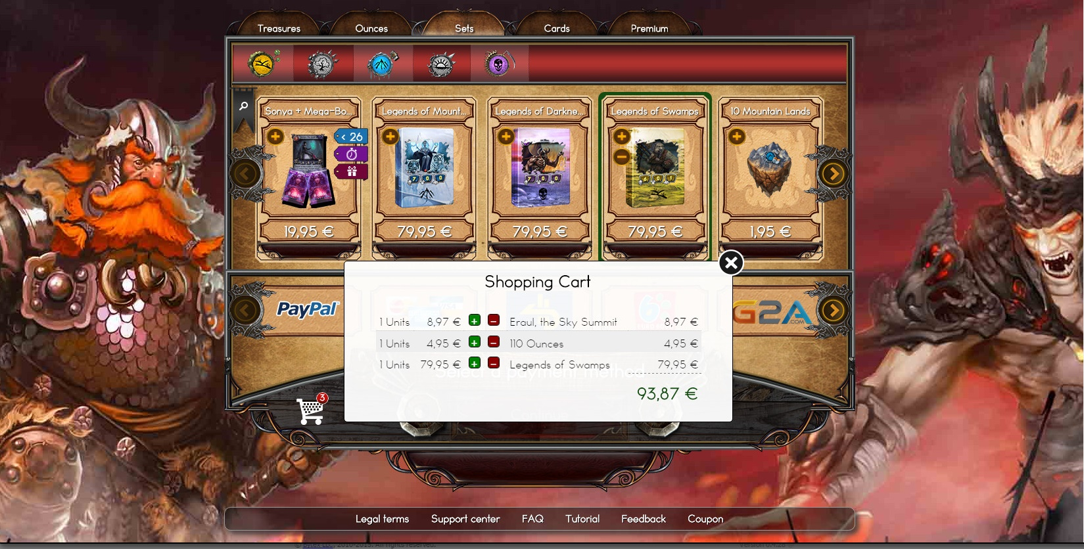
Shopping cart

Slide 29

Shop Example

Slide 30
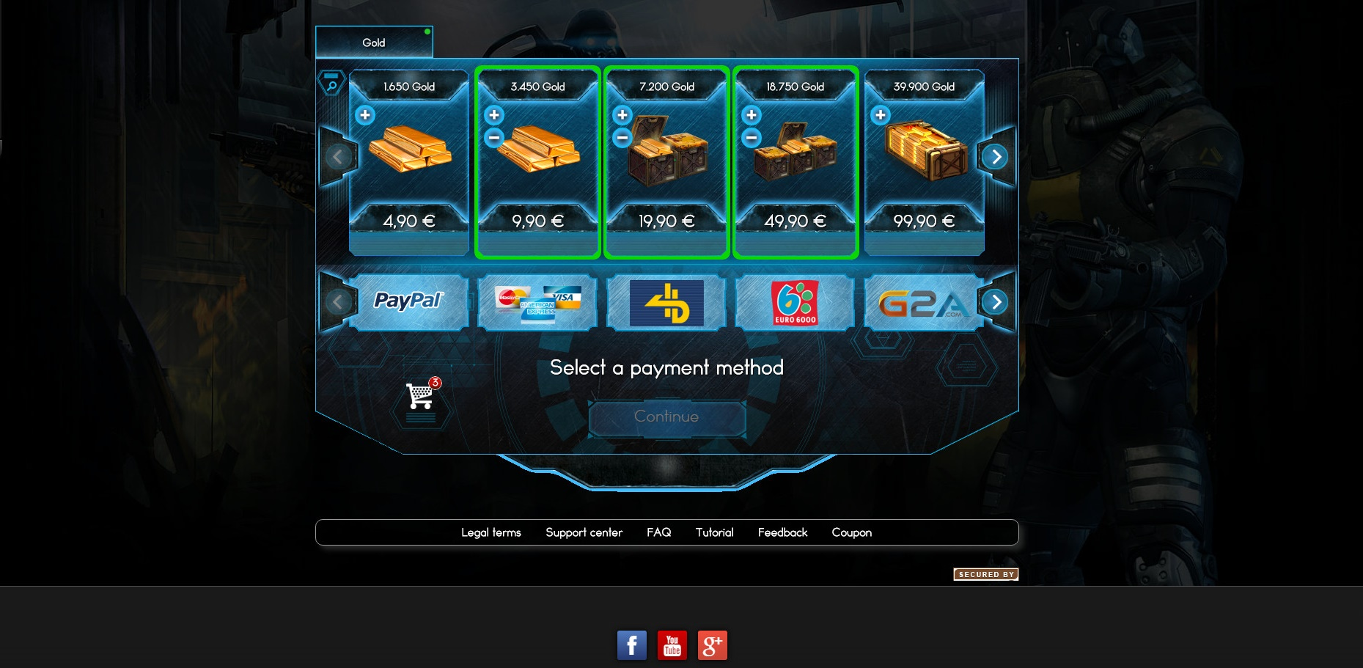
Shop Example

Slide 31
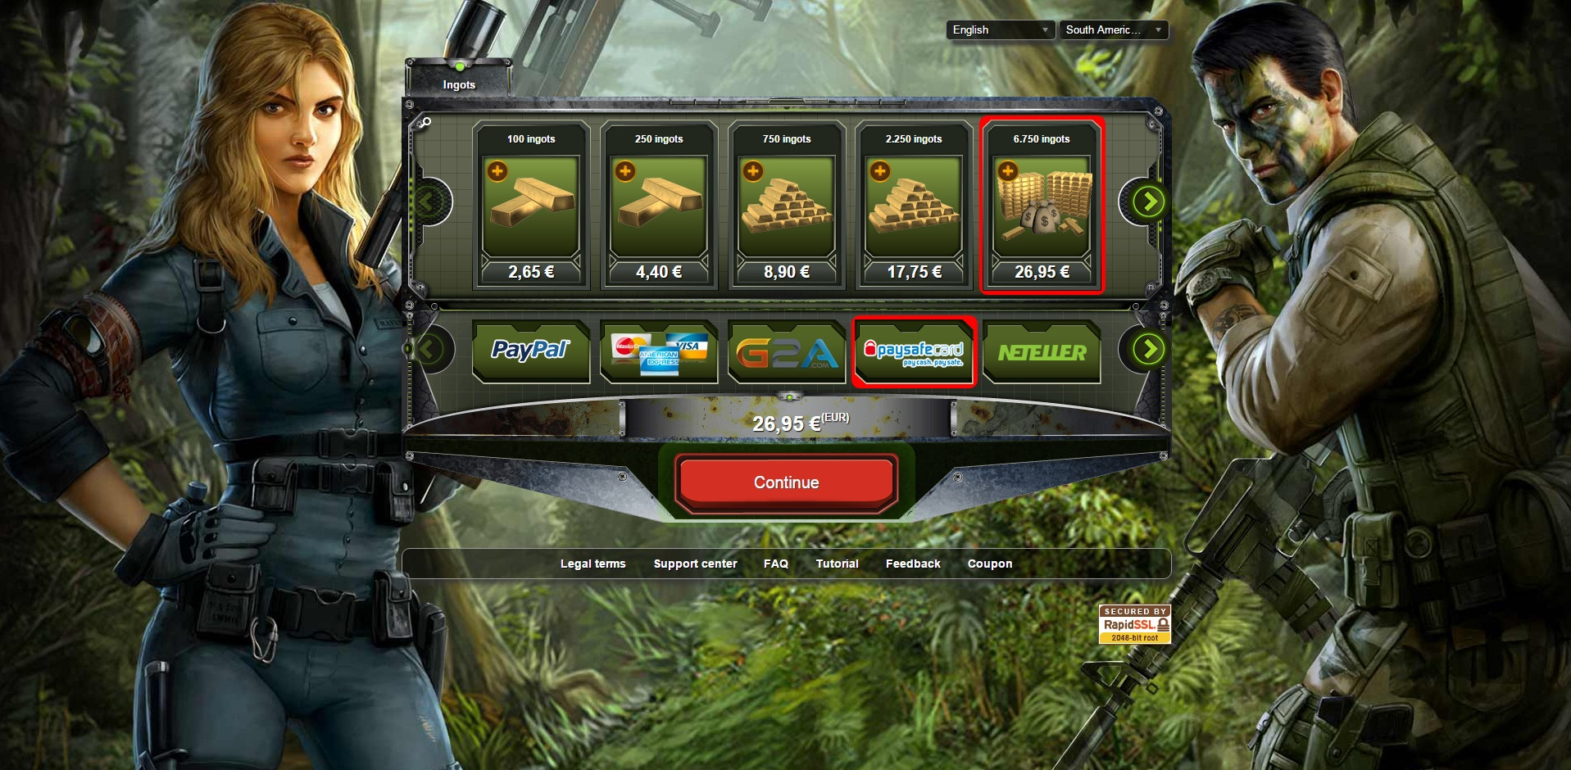
Shop Example

Slide 32

Thanks
dmorillo@wolopay.com

